Slide 1

CAPSTONE PROJECT
Geospatial Imaging for Crop Suitability in Kenya
Using satellite imagery and machine learning for smarter agriculture

Slide 2
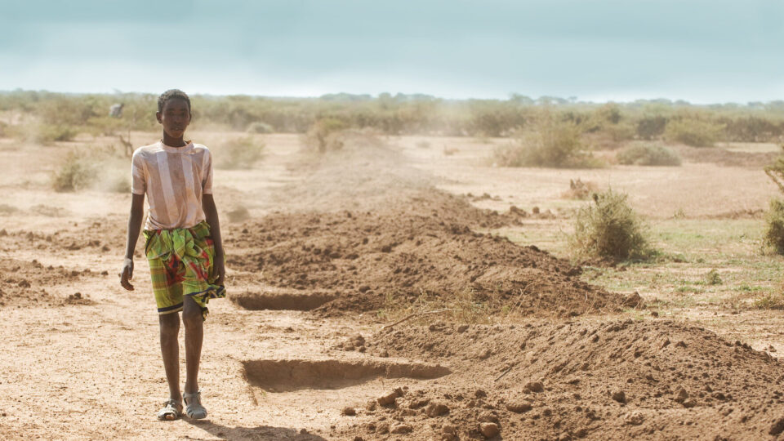
Navigating Agricultural Uncertainty
Kenyan farmers face difficulty with crop placement due to Lack of accessible data.
Notes:
Kenyan farmers face difficulty with crop placement due to Lack of accessible data.
Such as climate variability and soil degradation.

Slide 3
Navigating Agricultural Uncertainty
Lack of accessible, data results in:
Poor decision-making
Low crop yields
Increased risk
Notes:
A lack of accessible data leads to poor decisions, low yields and increased risk
Without precise insights, farmers gamble on crop choices, risking livelihoods and food security.

Slide 4
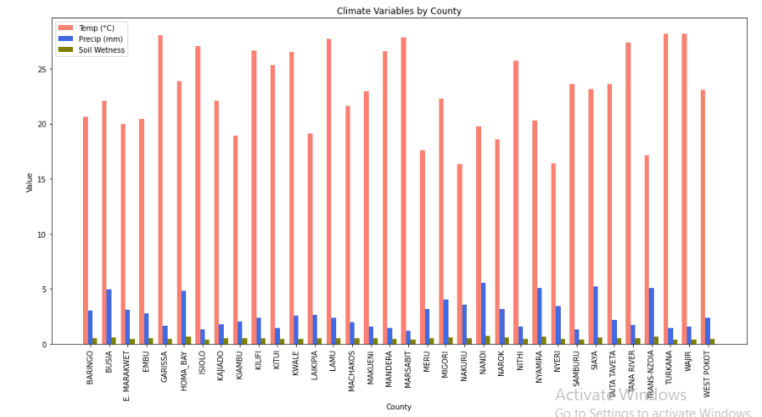
Navigating Agricultural Uncertainty
Notes:
The changing climate patterns have led to profound implications for crop production,particularly in counties heavily reliant on agriculture for food security and economic stability.

Slide 5
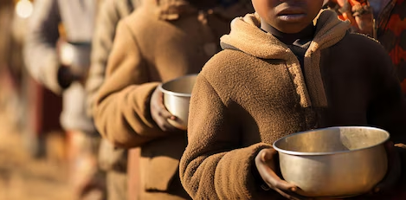
Impact of the 2024 Droughts
Severe decline in agricultural production.
Families lost:
Cattle
Crops
Livelihoods
Millions of children under age five faced malnutrition
Notes:
During the 2024 Droughts, the agricultural sector had seen a steep decline in production. Families lost cattle, crops and livelihoods, and unfortunately millions of children under the age of five were malnourished and urgently needed nutrition

Slide 6
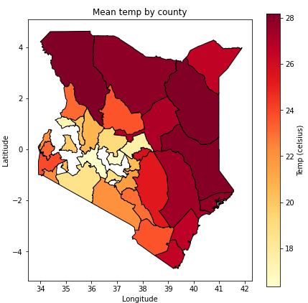
Navigating Agricultural Uncertainty
Crop placement must be data-driven.
Precision farming helps:
Maximize yields
Safeguard livelihoods
Notes:
Kenya’s weather is increasingly unpredictable
Precision farming helps:
Maximize yields
Safeguard livelihoods

Slide 7
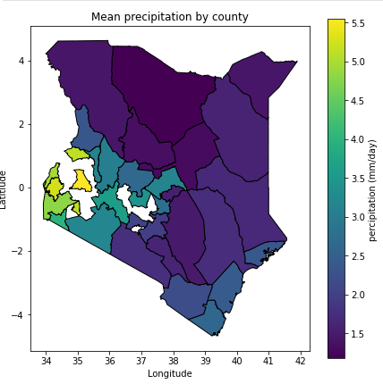
Navigating Agricultural Uncertainty
By planting at the perfect time and conditions will lead to:
Cost savings (e.g., fertilizer, water).
Efficiency in growth.
Notes:
Strategic planting at the optimal season not only enhances crop performance—it slashes input costs by minimizing wasted water, fertilizer, and labor
plants use enzyme catalysed reactions to boost growth
By planting at the perfect time and conditions will lead to: Cost savings from reduced input (e.g., fertilizer, water). Efficiency in growth as

Slide 8
Navigating Agricultural Uncertainty
Drip Irrigation: KES 75,000 – 160,000 per acre
Sprinklers: KES 500 – 45,000 (varies by type and size)
Rain Hoses: KES 75,000 – 110,000 per acre
Notes:
ainfall replaces the need for artificial irrigation, lowering reliance on costly systems like drip lines, sprinklers, or rain hoses.
Drip irrigation systems cost between KES 75,000 to KES 160,000 per acre. Sprinklers range from KES 500 to KES 45,000. Rain hoses can cost between KES 75,000 to KES 110,000 per acre

Slide 9



Objectives
Enhancing Crop Suitability Mapping in Kenya
Develop Predictive Mapping for Kenya’s Agricultural Planning
Model Development
Notes:
Basically our objectives focus on improving agriculture in Kenya through data-driven solutions.
Our first goal is to enhance crop suitability mapping in Kenya using geospatial data and machine learning.
Second, we aim to develop predictive mapping tools to help farmers and policymakers make data-driven decisions.
Finally, we will build and refine machine learning models to ensure accurate, scalable, and practical deployment in real-world conditions.

Slide 10
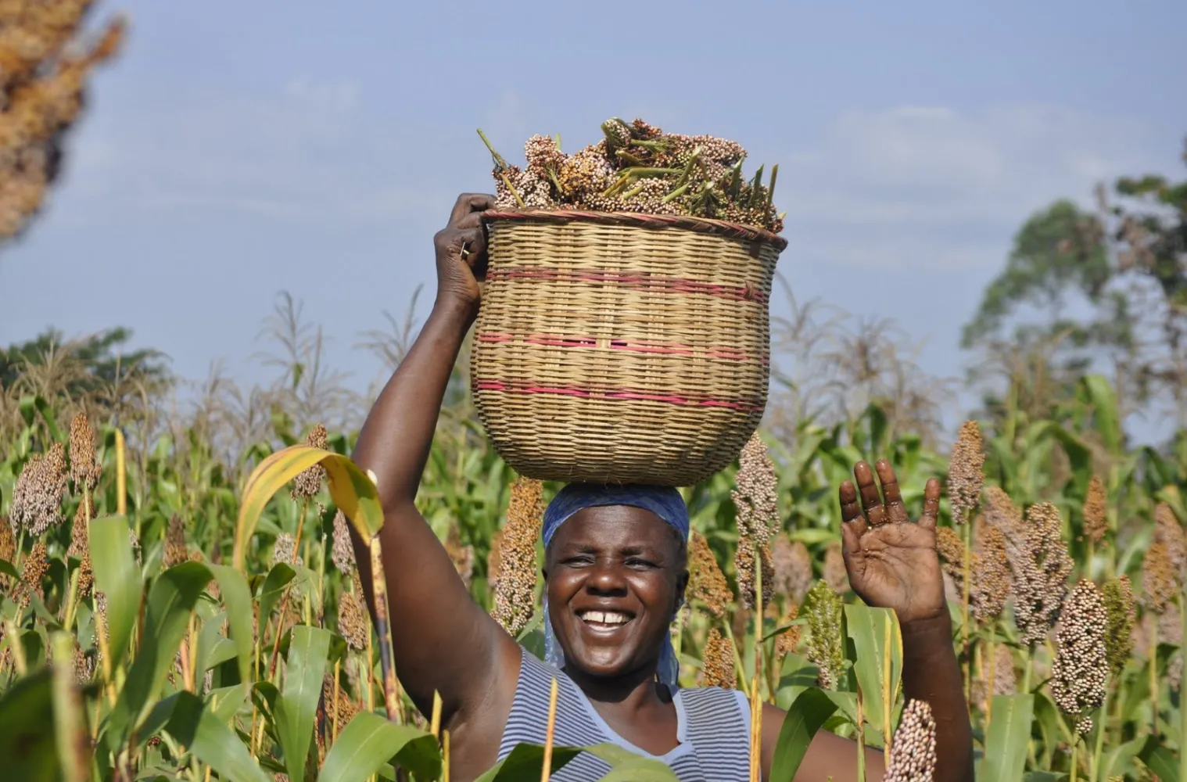

Stakeholders:
Farmers
Extension officers
Ministry of Agriculture
AgriTech Developers
NGOs & Donors

Slide 11



Modeling Approach:
Random Forest
XGBoost
Convolutional Neural Network
Notes:
We explored a diverse set of machine learning models to identify the most effective approach for predicting crop suitability, ranging from ensemble methods to deep learning

Slide 12
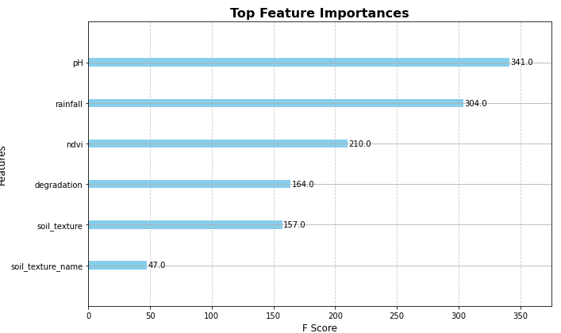
Feature Importance:
Notes:
This chart shows the top most influential environmental factors that matter most when identifying suitable crop zones.

Slide 13
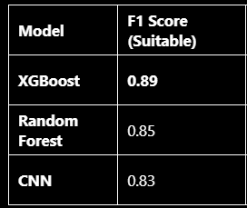
Model Comparison Results: XG Boost Leads
XGBoost outperformed other models with the F1 score of 0.89.
It reliably identifies suitable areas while minimizing errors.
Notes:
XGBoost outperformed other models with the best balance of precision, recall, and accuracy, achieving an F1 score of 0.89 : showing it reliably identifies suitable areas while minimizing errors.

Slide 14

Model Comparison Results: XG Boost Leads
XGBoost: Highest accuracy and generalization.
Best for real-world deployment.
F1 Score
Recall
Precision
Accuracy
Notes:
XGBoost outperformed other models in accuracy and generalization, making it ideal for real-world deployment

Slide 15
Recommendations
Add multi-class classification for multiple crops
Validate with field data and expert input
Improve CNN with more data and augmentation
Notes:
We plan to expand our model from single-crop suitability to multi-class classification, enabling it to handle several crop types simultaneously.
To ensure accuracy, we will validate predictions with real field data and work closely with local agronomists who understand on-the-ground conditions.
Finally, we will strengthen our CNN pipeline by adding more geolocated training samples and using data augmentation techniques to improve performance.

Slide 16


Kenya grapples with worst drought in four decades – The North Africa Post
Data is critical tool as farmers fight drought in Kenya - Kenya | ReliefWeb
The Impact of Climate Change on Crop Production in Kenya
Irrigation Farming in Kenya | 0790719020 | Aqua Hub Kenya

